Slide 1
World Happiness 2015 - 2021
The exploration of global happiness and its driving factors
Jonathan Lampkin

Slide 2
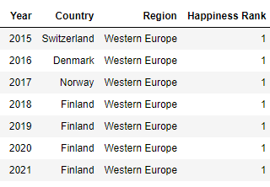
Happiest Countries by Year

Slide 3
Features
GDP per Capita:
Value of produced goods and services divided by the population
Social Support:
Having relatives or friends to help in times of trouble
Life Expectancy:
Average expected life duration
Freedom:
Perception of free will
Perceptions of Corruption:
Belief in widespread government and business corruption
Generosity
Those who had donated in the past month

Slide 4
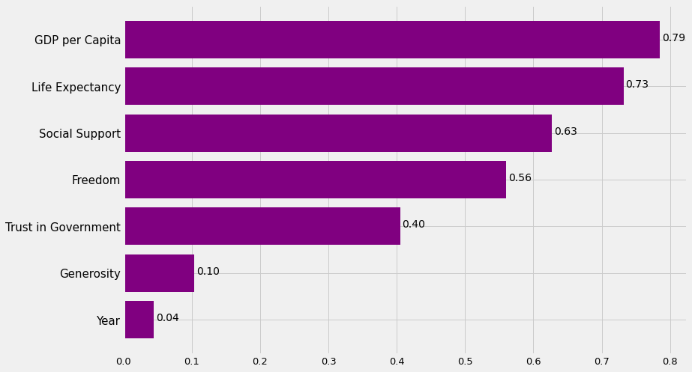
Correlations with Happiness

Slide 5
Hypothesis Statement 1
Purchasing Power Parity would be a more suitable metric over the Nominal GDP for this study.

Slide 6
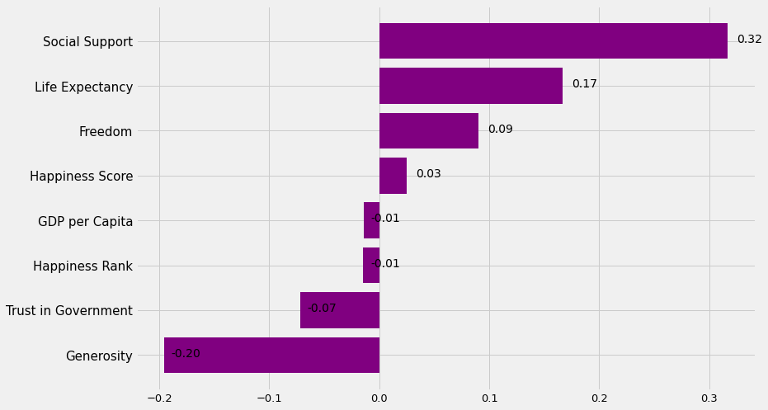
Correlations with Year

Slide 7
Insights
Positive correlation of Social Support and Year likely an effect of communicative technological advancements and usage.
Positive correlation of Life Expectancy and Year is likely caused by advancements in medicine and healthcare technology.

Slide 8
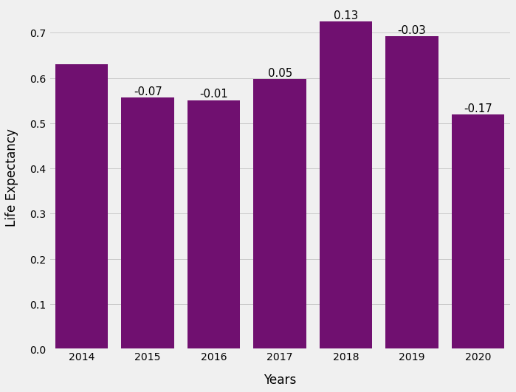
Change in Life Expectancy

Slide 9
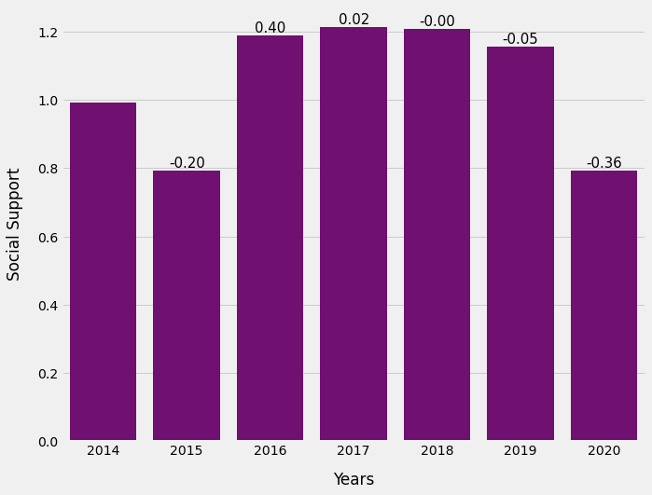
Change in Social Support

Slide 10
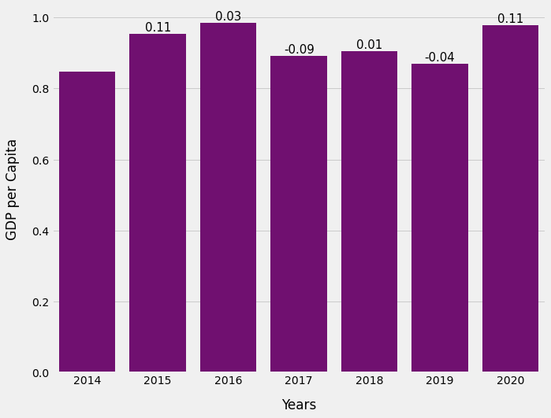
Change in GDP per Capita

